Slide 1
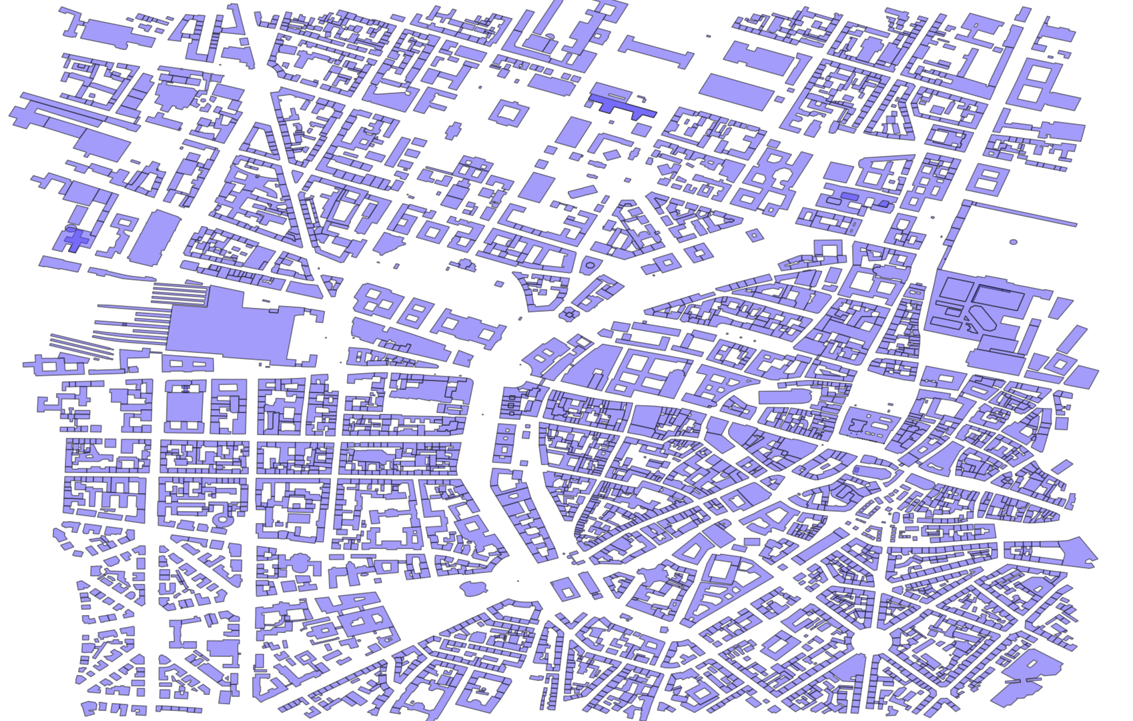
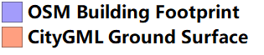
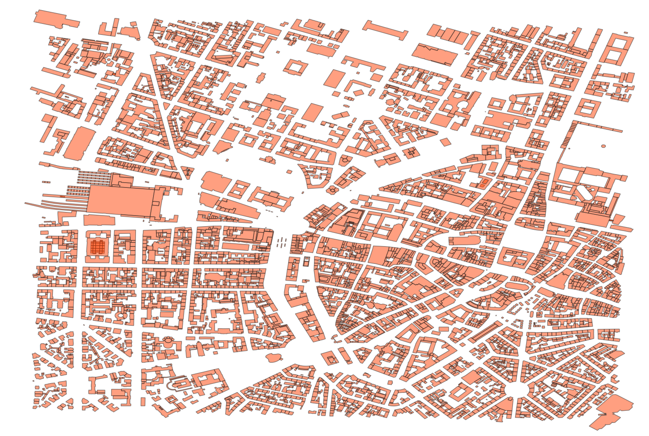
A Python Script for Spatial Joining for CityGML and OSM （v2.1）
Input: CityGML, OSM
Function:
Conversion from CityGML to Shapefile
Linking the polygons in the same place
Output: two Index tables and a Statistic table (CSV)
1

Slide 2
Requirements
geopandas
Fiona
Shapely
gdal
pyproj

Slide 3
Function
Conversion from CityGML to Shapefile
Extracting the geometry and gml_id of Ground Surface
Storing in Shapefile format
Spatial join
Removing the non-buildings from OSM data
Unifying spatial reference system
Matching polygons in the same place
Searching for the adjacent polygons of the matched polygons
Counting the matching relationships (1:1, m:n, m:1, 1:0, 1:n, 0:1)

Slide 4


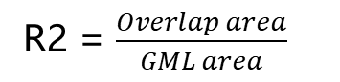
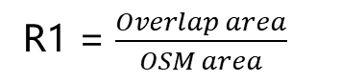
Identify matches in the same place
R1 = $\frac{Overlap area}{OSM area}$
R2 = $\frac{Overlap area}{GML area}$
Tolerance threshold t
(a) R1 > t , R2 > t -> Same
(b) R1 <= t , R2 > t -> Part of
osm1
osm1
match
gml1
gml1
match
(c) R1 > t , R2 <= t -> Part of
(d) R1 <= t , R2 <= t -> Not match
osm1
osm1
not match
gml1
match
gml1
4

Slide 5
Searching for adjacent polygons of the matched polygons
osm1
osm1
osm2
osm3
osm2
gml1
gml1
Return：
Matched: osm1
Adjacent: osm2
Return：
Matched: osm1, osm2
Adjacent: osm3
5

Slide 6
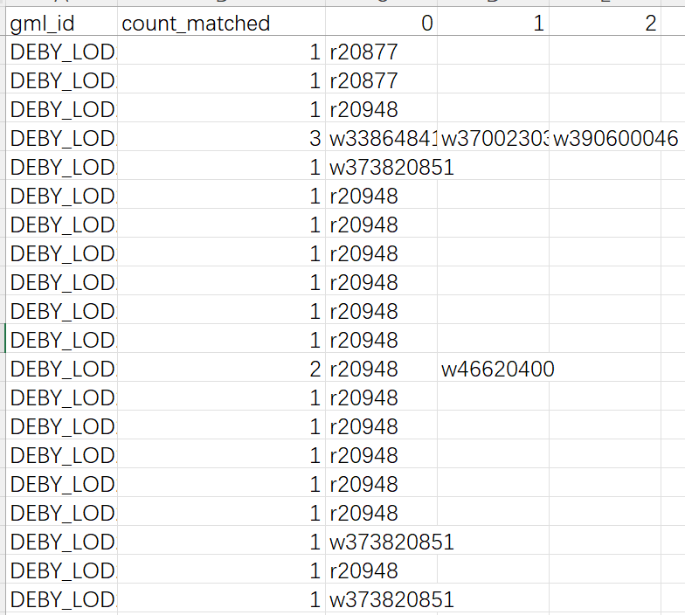
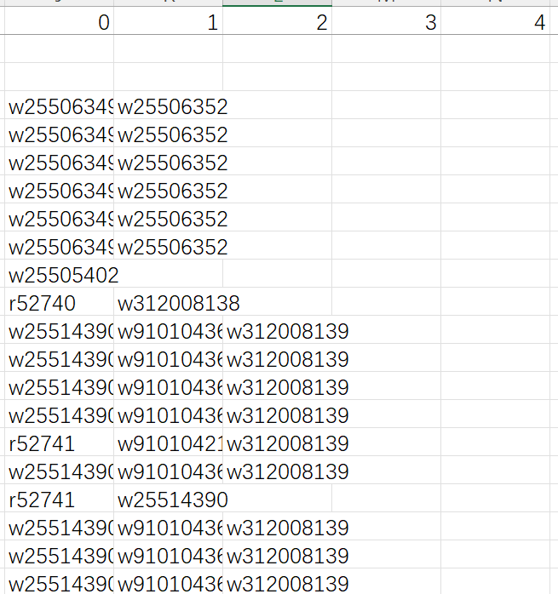
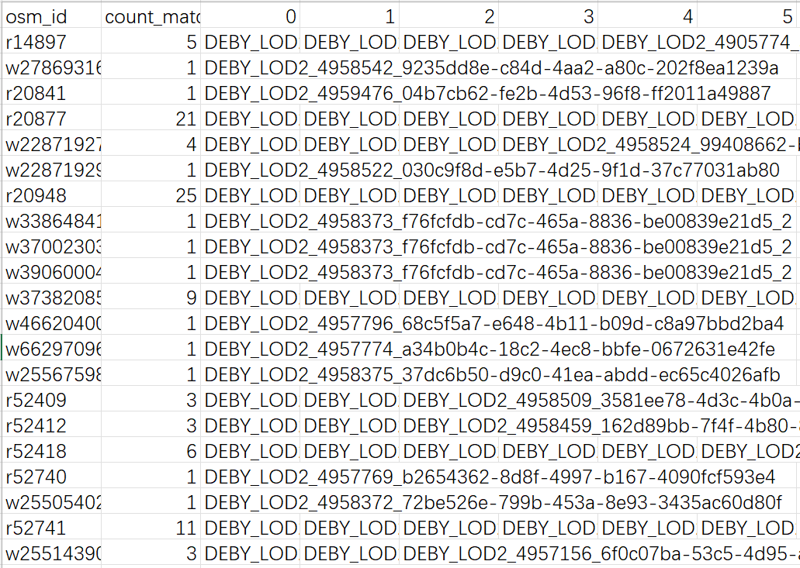
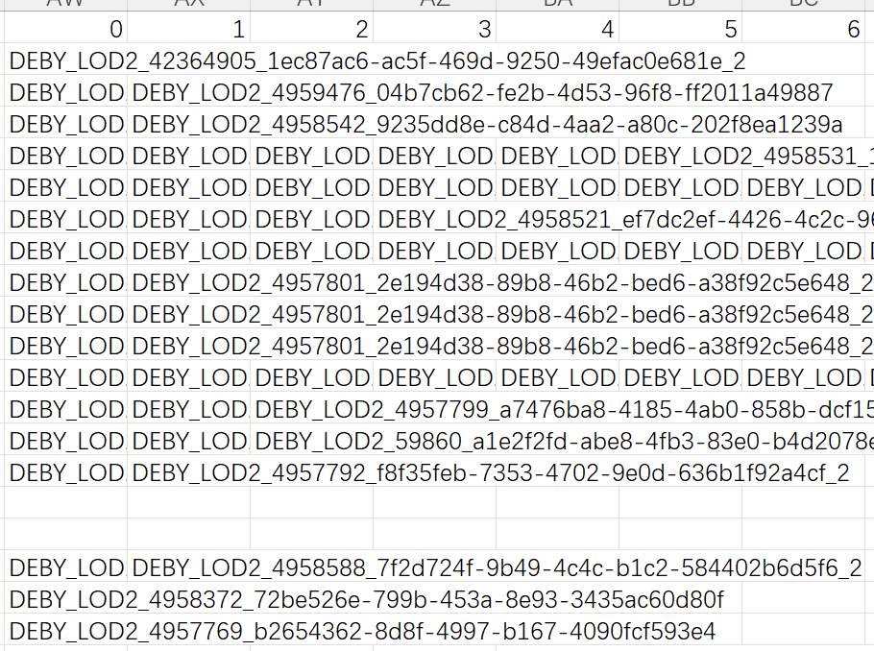
Output
Adjacent polygons of the matched polygons
Matched polygons
Index table for GML data
Index table for OSM data
Statistics of the matching relations
6

Slide 7
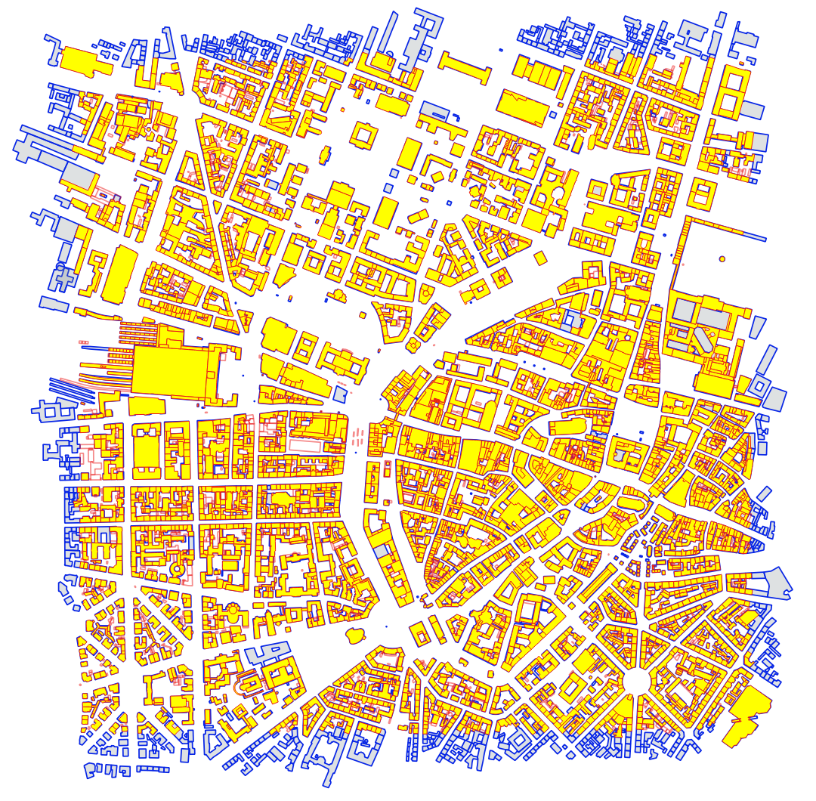
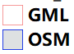
Output
t = 0.5
Matched GML
7

Slide 8
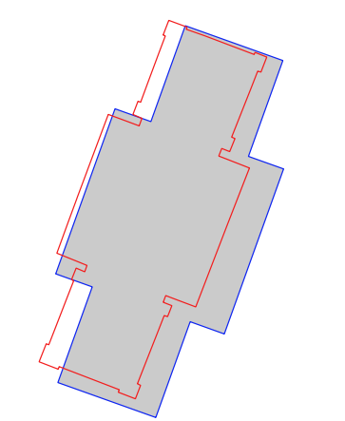
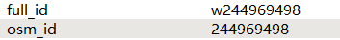
Output
OSM attributes
GML1 attributes
8

Slide 9
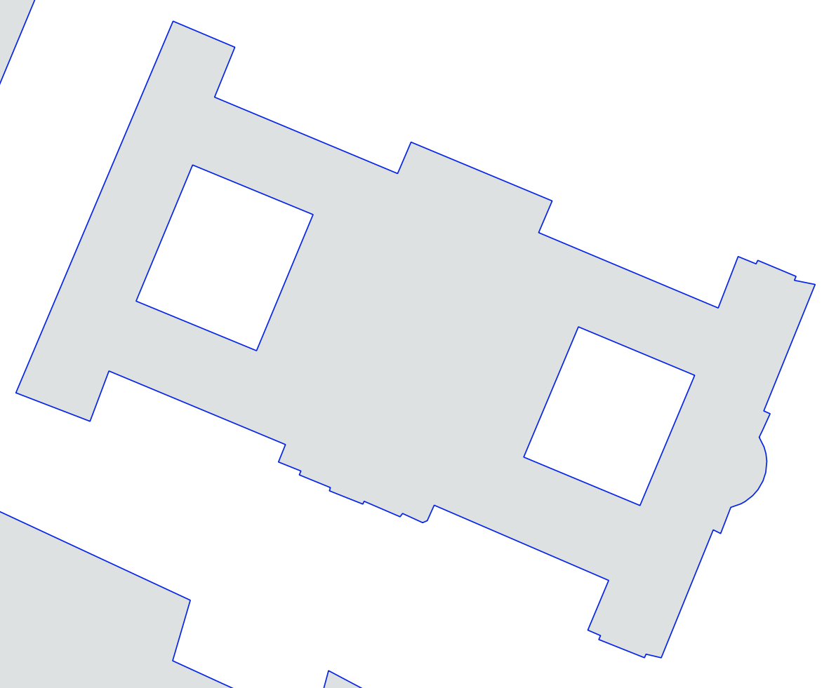
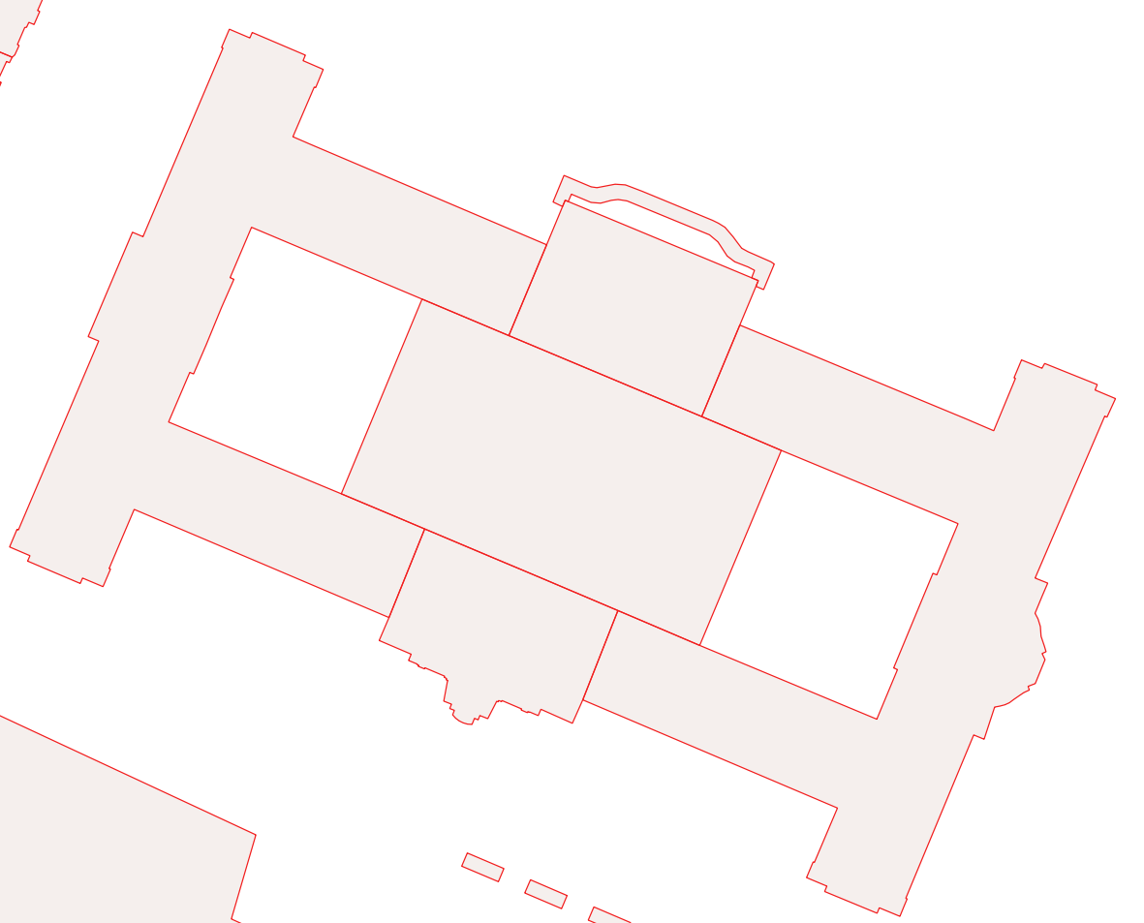
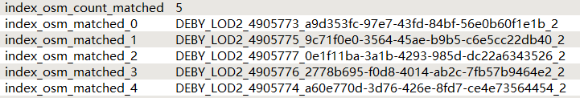
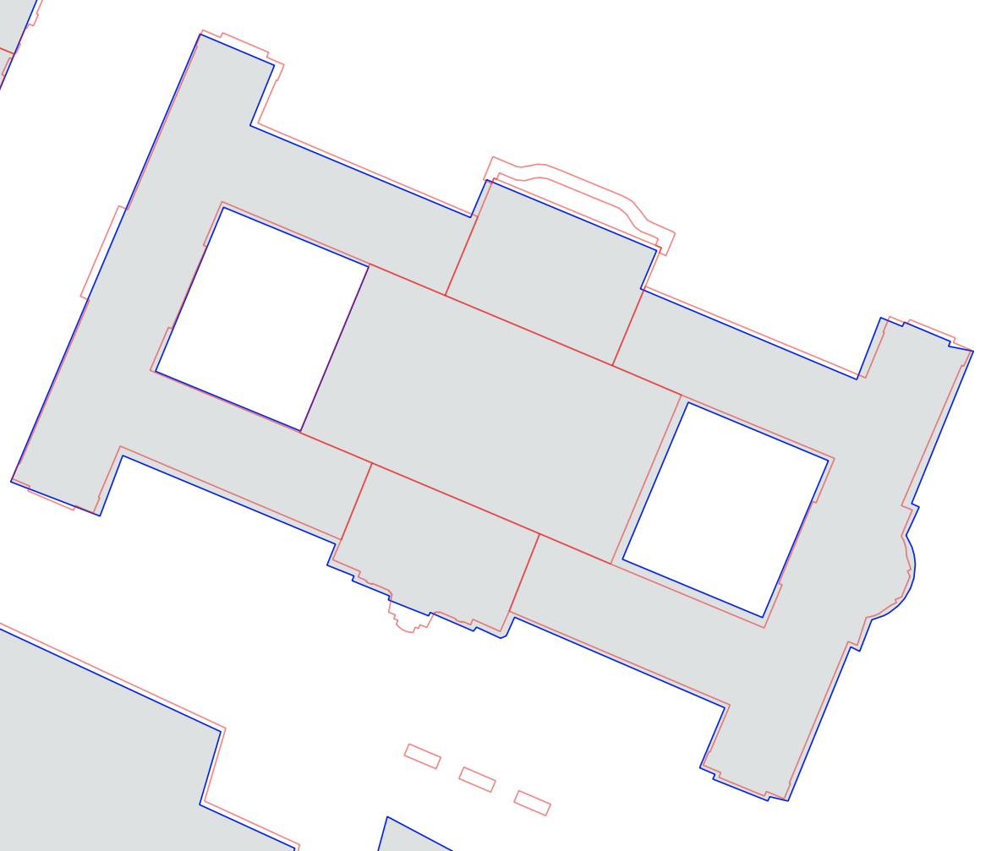
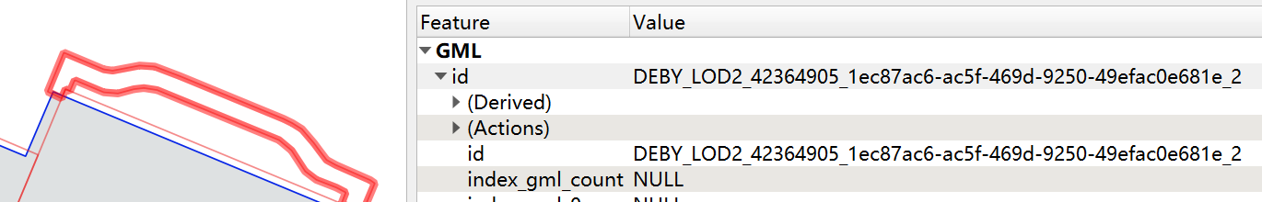
Output
OSM attributes
9

Slide 10
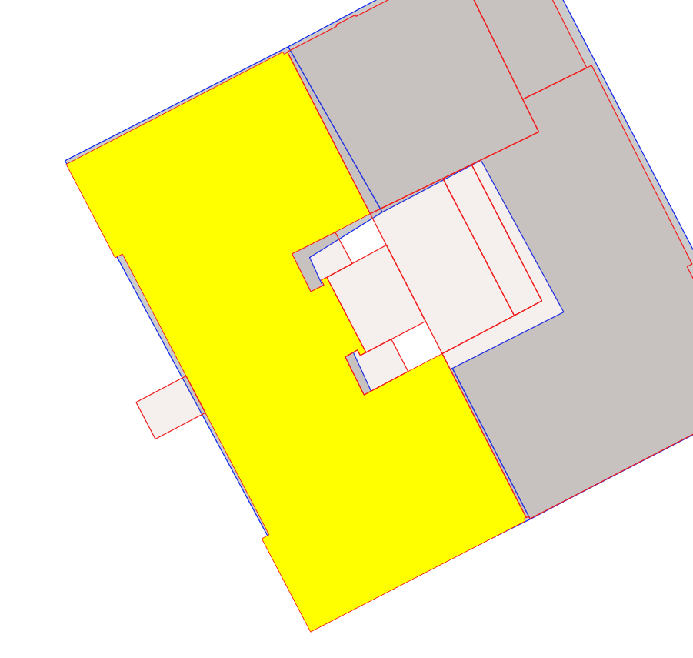
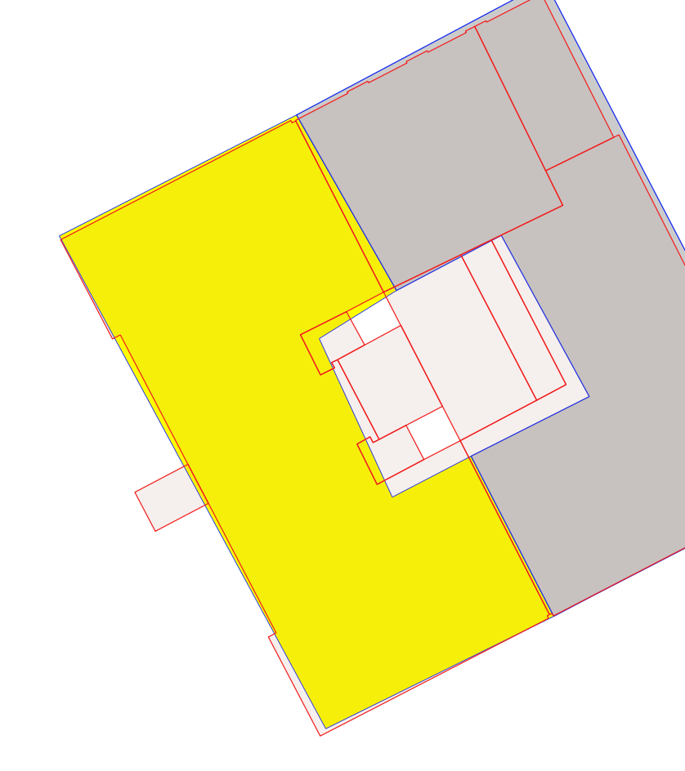
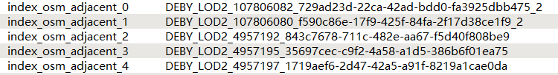
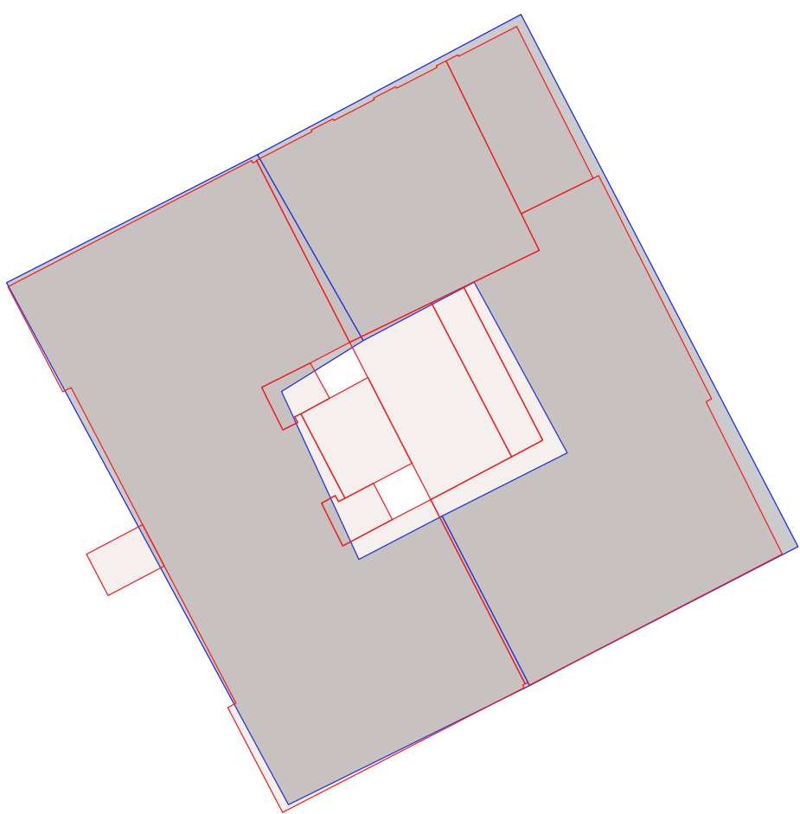
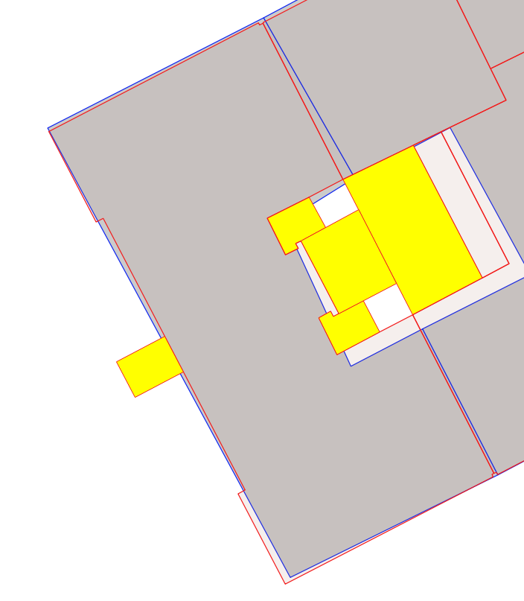
Output
Matched GML buildings
(c)
(a) OSM building
Adjacent GML buildings
(b)
(d)
10

